Slide 1
2.2 Normal Distributions
HW: p. 131 (41-59 odd, 63, 65, 66, 68-74)

Slide 2
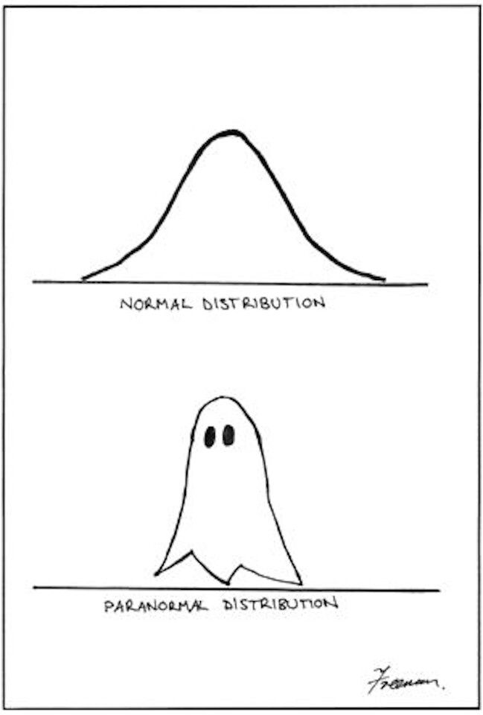
Preview
Density curves are a handy tool for modeling distributions of data.
This section is devoted entirely to the most common type of density curve – the Normal curve.
In this section, you will learn the basic properties of the Normal distributions and how to use them to perform a variety of calculations.
When performing calculations, you must interpret the results in the context of the situation!

Slide 3
Normal Distributions
Normal distributions play an IMPORTANT role in statistics. We see them a LOT.
We capitalize Normal to remind you that these curves are special.
The family of Normal curves share some characteristics that help us perform calculations about observations in a distribution of data:
They have the same overall shape: symmetric, single-peaked, bell-shaped.
The mean is at the center of the curve.
Almost all of the observations in an approximately Normal distribution will fall within three standard deviations of the mean.
We abbreviate as $N(μ,σ)$

Slide 4
Drawing Practice!
To sketch a Normal curve:
Draw a number line. Mark the center $μ$.
Draw three tick marks to the right of the center and three tick marks to the left (all evenly spaced). Label them $μ±σ, μ±2σ, μ±3σ$
Draw a dot above the mean where the peak of the curve will be.
Above the marks one standard deviation from the mean, draw dots about 60% as high as the dot above the mean.
Above the marks two standard deviations from the mean, draw dots about one-fourth as high as the previous dots.
Above the marks three standard deviations from the mean, draw dots just above the horizontal axis.
Connect the seven dots with a smooth curve.

Slide 5
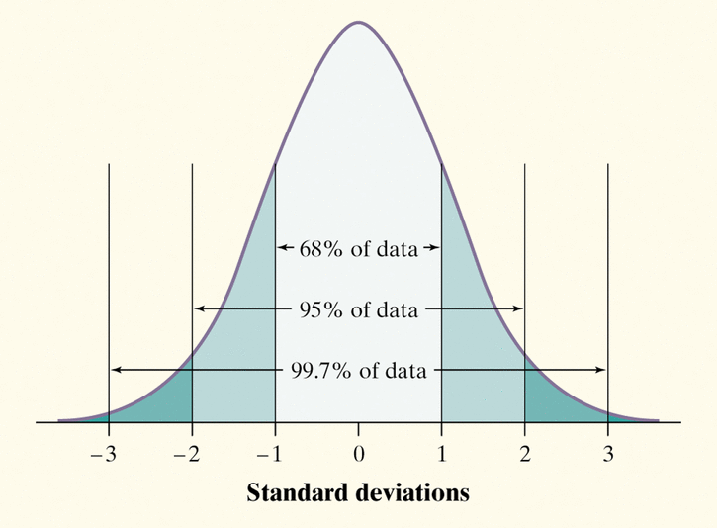
The 68-95-99.7 Rule (Empirical Rule)
In the Normal distribution with mean $μ$ and standard deviation $σ:$
Approximately 68% of the observations will fall within $σ$ of the mean $μ$.
Approximately 95% of the observations will fall within $2σ$ of $μ$.
Approximately 99.7% of the observations will fall within $3σ$ of $μ$.
This allows us to perform calculations about the approximate proportion of observations in a distribution that fall into certain intervals without even knowing all of the individual observations.

Slide 6
Check Your Understanding, p. 114
The distribution of heights of young women aged 18 to 24 is approximately N(64.5, 2.5).
Sketch a Normal density curve for the distribution of young women’s heights. Label the points one, two, and three standard deviations from the mean.
What percent of young women have heights greater than 67 inches? Show your work.
Approximately 16% of young women have heights greater than 67 inches.
What percent of young women have heights between 62 and 72 inches? Show your work.
Approximately 84% of young women have heights between 62 and 72 inches.
heights

Slide 7
Example
According to the CDC, the heights of 12-year-old males are approximately Normally distributed with a mean of 149 cm and a standard deviation of 9 cm.
Sketch the distribution, labeling the means and the points one, two, and three standard deviations from the mean.
About what percentage of 12-year-old boys will be over 158 cm tall?
About 165 of 12-year-old boys will be over 158 cm tall.
About what percentage will be between 131 and 140 cm tall?
About 13.5% of 12 year old boy will be between 131 and 140 cm tall.

Slide 8
Continued…
Suppose that a distribution of test scores is approximately Normal and the middle 95% of scores are between 72 and 84. What are the mean and standard deviation of this distribution?
Mean $=\frac{72+84}{2}=78$
SD $=\frac{84−72}{4}=3$
Can you calculate the percent of scores that are above 80? Explain.
Not yet….we only know how to calculate using the empirical rule. 80 lies before the first $σ$.

Slide 9
Time to practice!!!
Complete the practice worksheet using the 68-95-99.7 rule.
Due tomorrow!!!

Slide 10
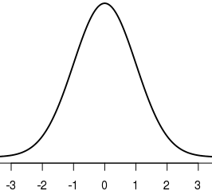
The Standard Normal Distribution
The standard Normal distribution is the Normal distribution with mean 0 and standard deviation $1$.
In practice, not all observations of interest will fall one, two, or three standard deviations from the mean.
In cases like this, the 68-95-99.7 rule can help us estimate the proportion, but we’ll want to be more exact.
We can use the standard Normal table and Normal calculations to help us find the proportion.

Slide 11
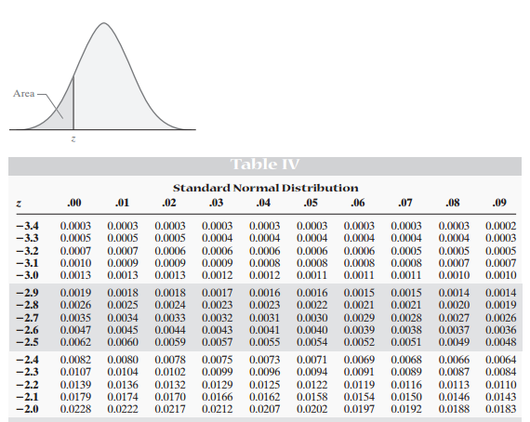
The Standard Normal Table
The Standard Normal Distribution Table is a table of areas under the standard Normal curve.
The table entry for each value z is the area under the curve to the left of z.
Suppose we want to find the proportion of observations from the standard Normal distribution that are less than $−2.15$.
Locate $−2.1$ in the left-hand column of the table.
Then locate the remaining digit $5$ as $.05$in the top row.
The entry opposite $−2.1$and under $.05$is $0.0158$. This is the area we seek.
*Since the area under the curve is $1$, the proportion of observations greater than $−2.15$is $1−0.0158=.9842$.

Slide 12
Check Your Understanding, p. 119
Use the standard Normal table to find the proportion of observations from a standard Normal distribution that fall in each of the following regions. In each case, sketch a standard Normal curve and shade the area representing the region.
$z<1.39$
0.9177
$z>2.15$
0.0158
$−0.56<z<1.81$
0.6772
Notes:
Have students sketch and show answers on board

Slide 13
Continued…
Use the standard Normal table to find the value z from the standard Normal distribution that satisfies each of the following conditions. In each case, sketch a standard Normal curve with your value of z marked on the axis.
The 20th percentile
-0.84
45% of all observations are greater than z.
0.13

Slide 14
Normal Distribution Calculations
We can answer a question about proportions of any Normal distribution by standardizing and then using the standard Normal table.
Follow the four-step process:
STATE: Express the problem in terms of a variable x.
PLAN: Sketch a picture of the distribution and shade the area of interest.
DO: Perform calculations by standardizing x and then using Table A or your calculator to find the required area under the Normal curve.
CONCLUDE: Write your conclusion in the context of the problem.

Slide 15
Example: Serving Speed
In the 2008 Wimbledon tennis tournament, Rafael Nadal averaged 115 miles per hour (mph) on his first serves. Assume that the distribution of his first serve speeds is Normal with a mean of 115 and a standard deviation of 6 mph.
About what proportion of his first serves would you expect to exceed 120 mph?
What percent of Rafael Nadal’s first serves are between 100 and 110 mph?
Notes:
About 20%
About 20%

Slide 16
Continued…
The fastest 30% of Nadal’s first serves go at least what speed?
What is the IQR for the distribution of Nadal’s first serve speeds?
Notes:
About 118.18 mph
About 8.1 mph

Slide 17
Continued….
A different player has a standard deviation of 8 mph on his first serves and 20% of his serves go less than 100 mph. If the distribution of his serve speeds is approximately Normal what is his average first serve speed?
Notes:
About 106.72 mph

Slide 18
Time to Practice!
Complete the practice worksheet using the standard Normal table.
Due tomorrow!!!

Slide 20
Yippee!!!
Your calculator will do Normal calculations for you!!!

Slide 21
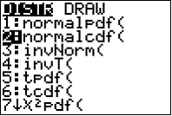
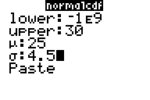
Finding Areas
2nd → vars
2:normalcdf(
Fill in information:
lower: left boundary
upper: right boundary
$μ$: mean
$σ$: standard deviation
Select Paste
*Older models will require you to input numbers in a list after selecting 2:normalcdf as follows:
2:normalcdf(lower, upper, mean, standard deviation)
Choose a very small or large number if there is no upper or lower boundary
Preset to 0
Preset to 1

Slide 22
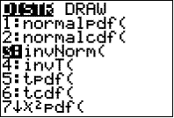
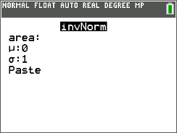
Finding Boundaries (when you know the area)
2nd → vars
3:invNorm(
Fill in the following:
Area: area to the left of the boundary
$μ$:
$σ$:
Select Paste
*Older calculators will require you to enter the information as a list after selecting 3:invNorm(
3:invNorm(area, mean, standard deviation)

Slide 23
AP Tip
When you show work on the AP Exam, you will lose credit for “calculator speak.”
You must show your work on Normal calculation questions or specify the operation and values you are using in your calculator!

Slide 24
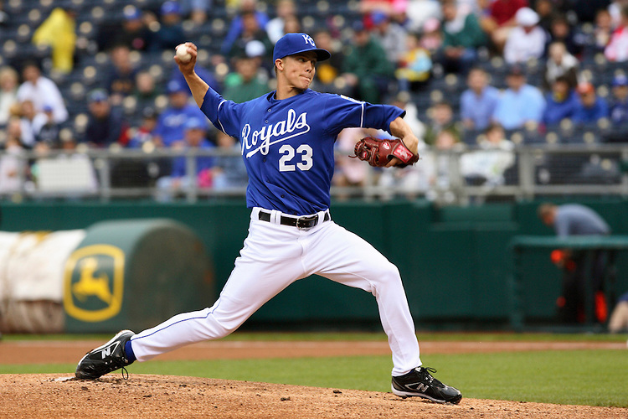
Example:
Suppose that Zack Greinke of the Kansas City Royals throws his fastball with a mean velocity of 94 miles per hour and a standard deviation of 2 mph and that the distribution of his fastball speeds can be modeled by a Normal distribution.
About what proportion of his fastballs with travel over 100 mph?
About what proportion of his fastballs will travel less than 90 mph?
About what proportion of his fastballs will travel between 93 and 95 mph?
What is the 30th percentile of Greinke’s distribution of fastball velocities?
Notes:
0.0013
0.0228
0.3829
92.95

Slide 25
Continued…
What fastball velocities would be considered low outliers for Zach Greinke?
$$μ−3σ=94−3\left(2\right)=below 88 mph$$
Suppose that a different pitcher’s fastballs have a mean velocity of 92 mph and 40% of his fastballs go less than 90 mph. What is his standard deviation of his fastball velocities, assuming his distribution of velocities can be modeled by a Normal distribution?
Use invNorm to find z. $invNorm(.4,0,1)=−0.2533$
Find standard deviation: $z=\frac{x−μ}{σ}$
$−0.2533=\frac{90−92}{σ}$
$σ≈7.9 mph$

Slide 26
Assessing Normality
Just because a distribution is symmetric, single-peaked, and bell-shaped, it is NOT necessarily Normal.
Before performing Normal calculations, you should be sure the distribution you are exploring really is Normal.
There are two methods to check for Normality:
68-95-99.7 rule
Probability Plots

Slide 27
68-95-99.7 Rule for Assessing Normality
Plot the data. Make a dotplot, stemplot, or histogram. See if the graph is approximately symmetric and bell-shaped.
Check whether the data follow the 68-95-99.7 rule. Count the number of observations within one, two, and three standard deviations of the mean.

Slide 28
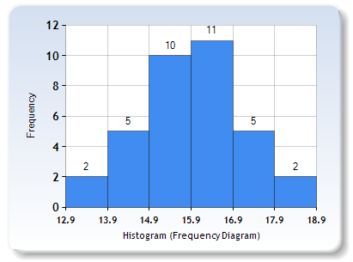
Example:
The measurements listed below describe the useable capacity (in cubic feet) of a sample of 36 side-by-side refrigerators. (Source: Consumer Reports, May 2010) Are the data close to Normal?
12.9 13.7 14.1 14.2 14.5 14.5 14.6 14.7 15.1 15.2 15.3 15.3 15.3 15.3 15.5 15.6 15.6 15.8 16.0 16.0 16.2 16.2 16.3 16.4 16.5 16.6 16.6 16.6 16.8 17.0 17.0 17.2 17.4 17.4 17.9 18.4
$$μ=15.825, σ=1.217$$
$$μ±1σ=\left(14.608,17.042\right)=\frac{24}{36}=66.7\%$$
$$μ±2σ=\left(13.391,18.259\right)=\frac{34}{36}=94.4\%$$
$$μ±3σ=\left(12.174,19.467\right)=\frac{36}{36}=100\%$$
These values are very close to what we would expect based on the 6895-99/7 rule. Combined with the graph, this gives good evidence that this distribution is close to Normal.
Capacity (ft³)

Slide 29
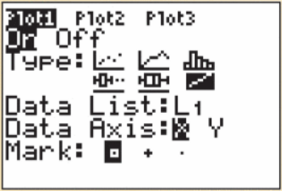
Probability Plots for Assessing Normality
Enter the data values in list 1
Stat
1:Edit
Enter values
Define Plot1 as shown to the right (2nd → $y=$)
Zoom
9:ZoomStat
If the points on the Normal probability plot lie close to a straight line, the plot indicates that the data are Normal.
Systematic deviations from a straight line indicate non-Normal distribution.
Outliers appear as points that are far away from the overall pattern of the plot.
Notes:
By hand: find z-score of each observation. Plot each observation x against the corresponding z.
x-values are best on the horizontal axis and z-scores on the vertical axis.

Slide 30
Example: Quiz Scores
Below are quiz scores. Construct a Normal probability plot to determine whether these data are approximately Normally distributed.
$0$ $0 1 2$
$$1 2 2 4 8$$
$$2 1 1 3 4 5 9 9$$
$$3 0 0 0 3 6$$
$$4 4 5 7$$
$$5 0$$
The Normal probability plot is fairly linear, so it is reasonable to assume that the scores follow a Normal distribution.

Slide 31
