Slide 1
2.1 Describing Location in a Distribution
HW: p. 105 (1, 5, 9-15 odd, 19-23 odd, 31, 33-38)

Slide 2
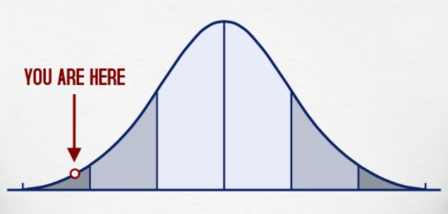
Overview
In this section, you will learn how to describe the location of an individual in a distribution.
This is a very important section and will reappear throughout the course.
Make sure to master the idea of standardized score!

Slide 3
Measuring Position: Percentiles
A common way to measure position within a distribution is to tell what percent of observations fall below the value in question.
The pth percentile of a distribution is the value with p percent of the observations less than it.
To find an individual’s percentile:
$$\frac{\# of individuals below }{total \# of individuals}∙100$$
*Percentiles should be whole numbers, so make sure to always round to the nearest integer.

Slide 4
Example: Wins in Baseball
The stemplot shows the number of wins for each of the 30 Major League Baseball teams in 2009. Find the percentiles for the following teams:
The Colorado Rockies, who won 92 games.
The New York Yankees, who won 103 games.
The Kansas City Royals and Cleveland Indians, who both won 65 games.
*Using this method, an observation will never fall at the 100th percentile. An alternate method uses all the observation less than or equal to it, which can result in the 100th percentile. Either method is fine to use on the AP exam.
$\frac{24}{30}=$ 80th percentile
$\frac{29}{30}=$ 97th percentile
$\frac{3}{30}=$ 10th percentil3

Slide 5
Cumulative Relative Frequency Graphs
Cumulative relative frequency graphs, or ogives, provide a graphical tool to find percentiles in a distribution.
$$\frac{frequency}{total individuals}$$
Add counts for current class and all previous classes
$$\frac{cumulative frequency}{total individuals}$$
Given frequencies
Notes:
*Data from p. 86 for the ages of the first 44 U.S. presidents when they were inaugurated.

Slide 6
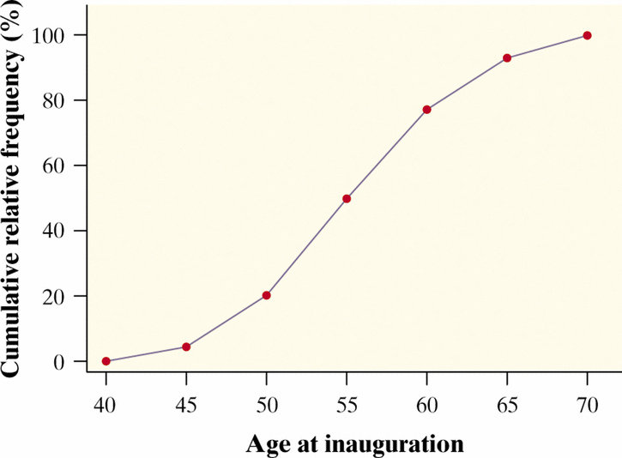
Graph it!
Start at 0.
Plot each cumulative relative frequency.
Connect each point with a segment.
Label your axes!!!!

Slide 7
Interpreting the graph:
1. What do the steepest segments tell us?
The cumulative relative frequency is increasing quickly. Between age 50 and 60 is where the most rapid growth occurs, so most presidents were in their 50s when they were inaugurated.
2. About what percent of presidents were younger than 55 at inauguration?
About 50%
3. About what percent of presidents were between 55 and 59 when they were inaugurated?
77% - 50% = 27%

Slide 8
Check Your Understanding, p. 89
Mark receives a score report detailing his performance on a statewide test. On the math section, Mark earned a raw score of 39, which placed him at the 68th percentile. This means that
Mark did better than about 39% of the students who took the test.
Mark did worse than about 39% of the students who took the test.
Mark did better than about 68% of the students who took the test.
Mark did worse than about 68% of the students who took the test.
Mark got fewer than half of the questions correct on this test.
C

Slide 9
Continued…
Mrs. Munson is concerned about how her daughter’s height and weight compare with those of other girls of the same age. She uses an online calculator to determine that her daughter is at the 87th percentile for weight and the 67th percentile for height. Explain to Mrs. Munson what this means.
Her daughter weighs more than 87% of girls her age and she is taller than 67% of girls her age.

Slide 10
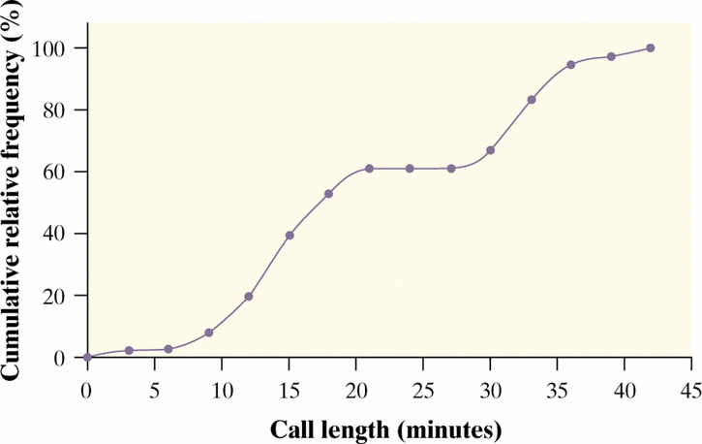
Continued…
The graph displays the cumulative relative frequency of the lengths of phone calls made from the mathematics department office at Gabalot High last month.
About what percent of calls lasted less than 30 minutes? 30 minutes or more?
About 65% of calls lasted less than 30 minutes. About 35% of calls lasted 30 minutes or longer.
Estimate $Q_{1}$, $Q_{2}$ and the IQR
The first quartile (25th percentile) is at about 14 minutes. The third quartile (75th percentile) is at about 32 minutes. IQR = 32 − 14 = 18 minutes.

Slide 11
Measuring Position: z-scores
In order to accurately describe a distribution, we must consider center and spread.
The standardized value, or z-score, of an observation takes into account both of those measures.
The z-score tells us how many standard deviations above or below the mean a particular observation falls.
It allows us to describe the location of an individual in a distribution, and also allows us to compare positions of individuals in different distributions.

Slide 12
Some tips:
A z-score is not measured in the same units as the variable.
A z-score is directional. If it is positive, it means the observation is above the average. If it is negative, the observation is below the average.
When comparing z-scores from different distributions, it is important that the distributions be roughly the same shape.

Slide 13
How to find a z-score
If x is an observation from a distribution that has a known mean and standard deviation, the standardized value of x is
$$z=\frac{x−mean}{standard deviation}$$

Slide 14
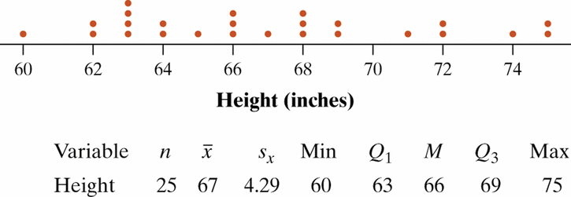
Check Your Understanding, p. 91
Mrs. Navard's statistics class has just completed the first three steps of the “Where Do I Stand?” Activity (page 84). The figure below shows a dotplot of the class’s height distribution, along with summary statistics from computer output.
Lynette, a student in the class, is 65 inches tall. Find and interpret her z-score.
$$z=\frac{65−67}{4.29}=.47$$
Lynette’s height is about 0.47 standard deviation below the mean height of the class.

Slide 15
Continued….
Another student in the class, Brent, is 74 inches tall. How tall is Brent compared with the rest of the class? Give appropriate numerical evidence to support your answer.
$$z=\frac{74−67}{4.29}=1.63$$
Brent’s height is about 1.63 standard deviations above the mean height of the class.
Brent is a member of the school’s basketball team. The mean height of the players on the team is 76 inches. Brent’s height translates to a z-score of –0.85 in the team’s height distribution. What is the standard deviation of the team members’ heights?
$$−0.85=\frac{76−67}{σ}$$
$$σ=2.35 inches$$

Slide 16
Transforming Data
When we find z-scores, we are actually transforming our data to a standardized scale.
Sometimes we transform data to switch between measurement units. When we do this, it is important to know what happens to the center and spread of the transformed distribution.
The center is affected by:
Addition/subtraction
Multiplication/division
The spread is affected by:
Multiplication/division
*Shape and location of observations will remain unchanged!

Slide 17
Example: Taxi Cabs
In 2010, taxi cabs in New York City charged an initial fee of $2.50 plus $2 per mile. In equation form, $fare=2.50+2(miles)$. At the end of a month, a businessman collects all his taxi cab receipts and calculates some numerical summaries. The mean fare he paid was $15.45, with a standard deviation of $10.20.
What are the mean and standard deviation of the lengths of his cab rides in miles?
Solve the formula for miles. $miles=\frac{fare−2.50}{2}$
Find mean: $\frac{15.45−2.50}{2}=6.475 miles$
Find standard deviation: $\frac{10.20}{2}=5.10 miles$
*addition/subtraction doesn’t affect the standard deviation.

Slide 18
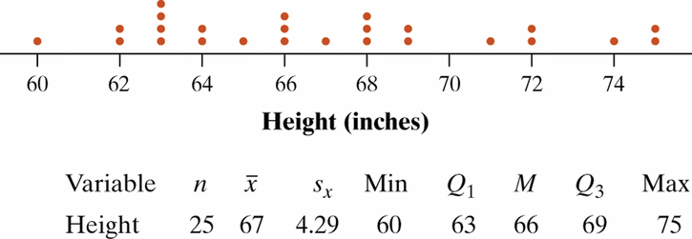
Check Your Understanding, p. 97
The figure below shows a dotplot of the height distribution for Mrs. Navard’s class, along with summary statistics from computer output.
Suppose that you convert the class’s heights from inches to centimeters (1 inch = 2.54 cm). Describe the effect this will have on the shape, center, and spread of the distribution.
The shape will not change. The center and spread will be multiplied by 2.54.

Slide 19
Continued…
If Mrs. Navard had the entire class stand on a 6-inch-high platform and then had the students measure the distance from the top of their heads to the ground, how would the shape, center, and spread of this distribution compare with the original height distribution?
The shape and spread will not change. The center will have 6 inches added to it.
Now suppose that you convert the class’s heights to z-scores. What would be the shape, center, and spread of this distribution? Explain.
The shape will not change. The mean will change to 0 and the standard deviation will change to 1.

Slide 20
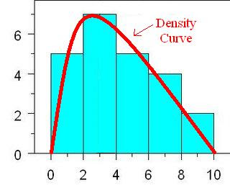
Density Curves
When we have a large number of observations, we can describe the overall pattern using a smooth curve called a density curve.
A density curve:
is always above the horizontal axes
has area exactly 1 underneath it.
No real set of data is exactly described by a density curve. It is an approximation that is easy to use and accurate enough for practical use.

Slide 21
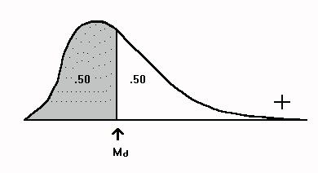
Under the Curve
Areas under a density curve represent proportions of the total number of observations.
The median is the “equal area” point, because half of the area is to the left and half is to the right.

Slide 22
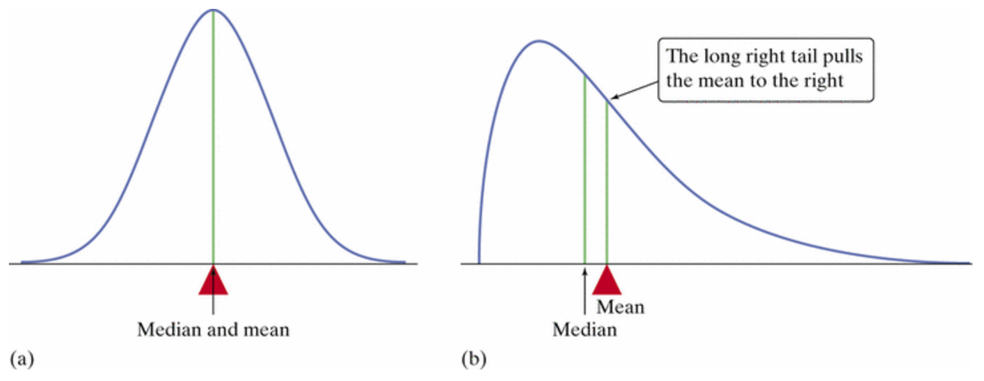
The Mean of the Curve
In a symmetric distribution, the mean and median will be the same.
In a skewed distribution, the mean will be pulled away from the median in the direction of the tail.
The mean is also the “balance point” of the distribution.

Slide 23
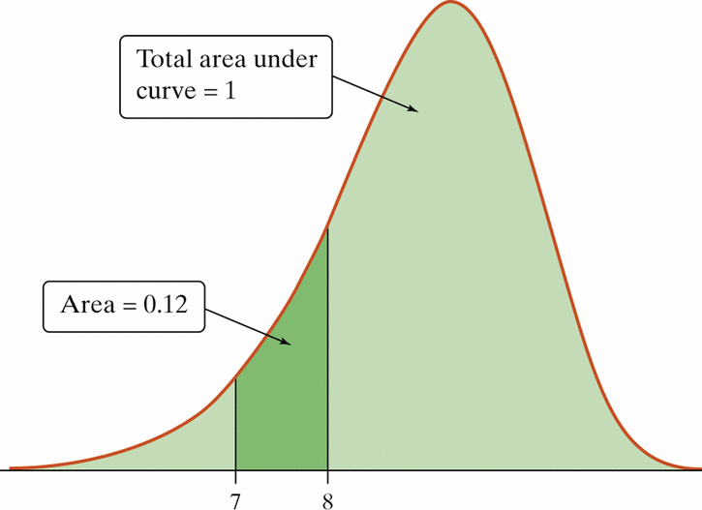
Check Your Understanding, p. 103
Use the figure shown to answer the following questions.
Explain why this is a legitimate density curve.
The curve is positive everywhere and it has total area of 1.
About what proportion of observations lie between 7 and 8?
About 12%
Mark the approximate location of the mean and median.
mean
median

Slide 24
Continued…
Explain why the mean and median have the relationship that they do in this case.
The mean is less than the median in this case because the distribution is skewed to the left.

